Slide 1
NPTEL
Video Course on Machine Learning
Professor Carl Gustaf Jansson, KTH
Week 6 Machine Learning based
on Artificial Neural Networks
Video 6.6 Hopfield Networks and Boltzman Machines – Part 2

Slide 2
Hopfield Networks
|
Related approaches

Slide 3
Boltzman Machines
Boltzmann machines are recurrent neural networks that can be seen as the stochastic, generative counterparts of Hopfield networks. The non-determinism allows the system to come out of local minima. Boltzman machines were invented in 1985 by Geoffrey Hinton and Terry Sejnowski.
They are also called stochastic Hopfield network with hidden units. Hidden units to enables the learning of higher order relationships and abstractions. As for Hopfield networks, we have symmetric connections between units.
Finding an optimal state involves relaxation: letting the network settle into a configuration that maximizes a goodness function. This is done by annealing.
Boltzman machines are named after the Boltzmann distribution in statistical mechanics, which is used in their sampling function. They are also called "energy based models" (EBM).
State changes occur either:
a. Deterministically when or
b. otherwise Stochastically with probability =
Where t is a decreasing temperature variable and
is the expected change in energy if the change is made.
Hidden unit
Visible unit

Slide 4
Learning in a Boltzman Machine
Step 1. Pick an example
Step 2. Run network in positive phase
Clamp the visible units with the pattern specified by our current example
Let network settle using the simulated annealing method
Record the outputs of the units
Reiterate 2a..2c
Step 3. Run network in negative phase
Don’t clamp the network units. We just let it settle to some state as before.
Reiterate 3a..3b
Step 4. Compare the statistics of the two phases
For each pair of units, we compute the odds that both units are coactive (both on) for the positive phase. Do it also for the negative phase.
If we have n units, this gives us two n x n matrices of probabilities
p_{i,j+ and} p_{i,j-} are the probabilities that both unit i and j are both on in the positive and negative phase
Step 5. Update the weights based on statistics
Change each weight according to the difference of the probabilities for the positive and negative phase
Dwij = k *(p_{i,j+} - p_{i,j- ).} Here, k is like a learning rate
Step 6. Go to step 1 and repeat.

Slide 5
Simulated Annealing - Source of Inspiration
Annealing in metals
Heat the solid state metal to a high temperature
Cool it down very slowly according to a specific schedule.
If the heating temperature is sufficiently high to ensure random state and the cooling process is slow enough to ensure thermal equilibrium, then the atoms will place themselves in a pattern that corresponds to the global energy minimum of a perfect crystal.

Slide 6
Simulated Annealing – steps in the algorithm
Step 1: Initialize Start with a random initial configuration. Initialize a very high “temperature”.
Step 2: Move Perturb the configuration through a defined move.
Step 3: Calculate score Calculate Score (Delta E in or case) due to the move made.
Step 4: Choose Depending on score (Delta E), accept or reject the move. The probability of acceptance depending on the current “temperature”.
Step 5: Update and repeat Update the temperature value by lowering the temperature.
Go back to Step 2. The process is done until “Freezing Point” is reached.

Slide 7
Simulated Annealing versus Greedy Algorithms

Slide 8
Restricted Boltzmann Machine (RBM)
A Restricted Boltzmann Machine (RBM) is a variant of a Boltzmann machine where the neurons must form a bipartite graph.
a pair of nodes from each of the two groups of units commonly referred to as the "visible" and "hidden" units respectively, may have a symmetric connection between them
there are no connections between nodes within a group.
By contrast, unrestricted Boltzmann machines may have connections between hidden units.
RBMs were initially invented under the name Harmonium by Paul Smolensky in 1986 but became acknowledged only after the development of faster learning algorithms in 2005 (Hinton et al.)

Slide 9
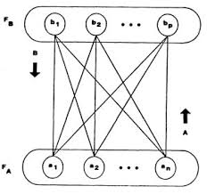
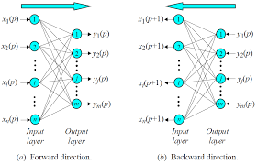
Bidirectional associative memory (BAM)
Bidirectional associative memory (BAM) is a type of recurrent neural network and associative memory . BAM is hetero-associative, meaning given a pattern it can return another pattern which is potentially of a different size. BAM was introduced by Bart Kosko in 1988.
A bi-directional associative memory (BAM) network is one with two fully connected layers, in which the links are all bi-directional. It is used to map a set of vectors Xi (input layer) to a set of vectors Yi (output layer). There can also be a feedback link connecting a node to itself.
If a BAM network is used to implement an auto-associative memory then the input layer is the same as the output layer, i.e., there is just one layer with feedback links connecting nodes to themselves in addition to the links between nodes. This network can be used to retrieve a pattern given a noisy or incomplete pattern.
A BAM network may be trained, or its weights may be worked out in advance.

Slide 10
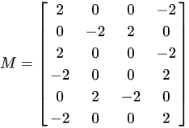
Bidirectional associative memory (BAM) - example
Two associations, A1:B1 and A2:B2. These are then transformed into the bipolar forms
A1 = (1, 0, 1, 0, 1, 0), B1 = (1, 1, 0, 0) X1 = (1, -1, 1, -1, 1, -1), Y1 = (1, 1, -1, -1)
A2 = (1, 1, 1, 0, 0, 0), B2 = (1, 0, 1, 0) X2 = (1, 1, 1, -1, -1, -1), Y2 = (1, -1, 1, -1)
T T
A matrix M can be calculated as X Y where X is the transpose of X.
1 * 1 1 -1 -1 1 * 1 -1 1 -1
-1 1
1 1
-1 + -1 =>
1 -1
-1 -1
To retrieve the association A1, we multiply it by M to get (4, 2, -2, -4)
If (4, 2, -2, -4) is run through a threshold => (1, 1, 0, 0), which is B1.
To retrieve the reverse association the transpose of M is used in a similar way.

Slide 11
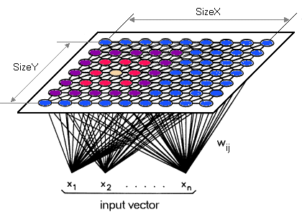
Kohonen Network or Self-Organizing Map (SOM)
SOM implements a form of unsupervised learning. SOM converts complex, nonlinear statistical relationships between high-dimensional data items into simple geometric relationships on a low-dimensional display (dimensionality reduction).
As it thereby compresses information while preserving the most important topological and metric relationships of the primary data items on the display, it may also be thought of to produce some kind of abstractions.
SOM can also be called or self-organizing feature map (SOFM) and was invented by Teuvo Kohonen in 1982.
The map space is predefined, usually as a finite two-dimensional region where nodes are arranged in a regular grid.

Slide 12
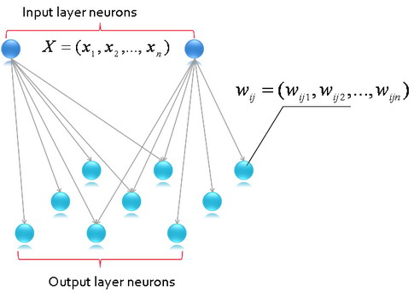
Kohonen Network or Self-Organizing Map (SOM)
Each node is associated with a weight vector with the same dimension as an input vector. Like most artificial neural networks, SOMs operate in two modes: training and matching.
Training consists of adapting weight vectors towards the input data, honoring the map space topology. Self-organizing maps differ from other artificial neural networks as they apply competitive learning as opposed to error-correction learning such as gradient descent. They also use a neighborhood function to preserve the topological properties of the input space.
Once trained, the map classifies an input vector by finding the node with the closest (smallest distance metric) weight vector to the input space vector.

Slide 13
NPTEL
Video Course on Machine Learning
Professor Carl Gustaf Jansson, KTH
Thanks for your attention!
The next lecture 6.8 will be on the topic:
Convolutional Networks

